Slide 1
Convolution Neural Networks
A Conceptual Introduction
Landon Buell
Nov 2019

Slide 2
Introduction
What does a “Convolutional Neural network” mean?

Slide 3
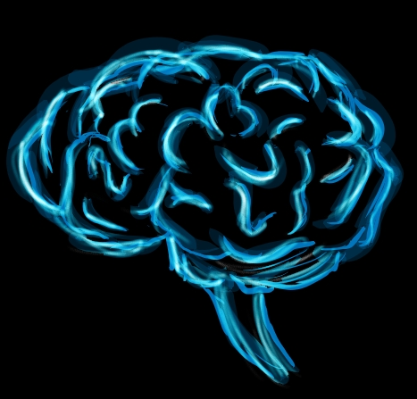
The Intent
Neural Networks are largest inspired from the brain (Sanderson)
Particularly the visual cortex
Using computers, can we mimic cognitive functions?
This Photo by Unknown Author is licensed under CC BY-SA

Slide 4

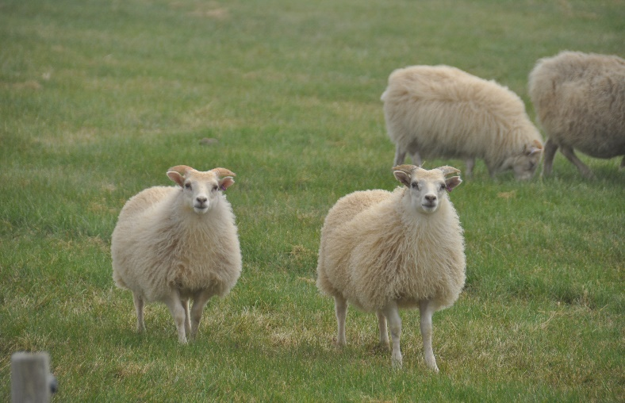
The Intent (Cont.)
CNNs have been used for visual recognition since the 1980’s (Geron)
Can computers be used to recognize qualities of images , audio, etc.?
I.e. which image has sheep? Which image has a whale?

Slide 5
Why “Neural”?
The basic unit of structure is a neuron
communicate by exchanging chemical signals
Function like mathematical operations
Take some input and return some output

Slide 6
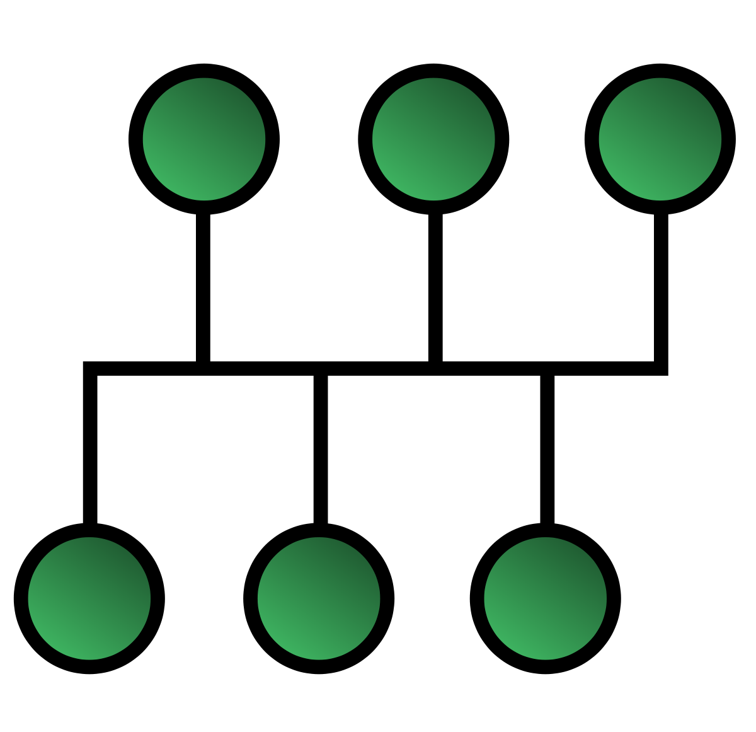
Why “Network”?
Much like the brain has collections of neurons, so too do CNN’s
It is a network of these neurons
This Photo by Unknown Author is licensed under CC BY-SA

Slide 7
Why “Convolutional” ?
Attributed to layers of network
Multiple layer exist and interact
This combination produces a final output

Slide 8
How Does it Work?
Demonstrated with a practical example

Slide 9
Input
We build CNNs as a very complicated connection of ‘functions’
Functions require inputs to produce outputs

Slide 10


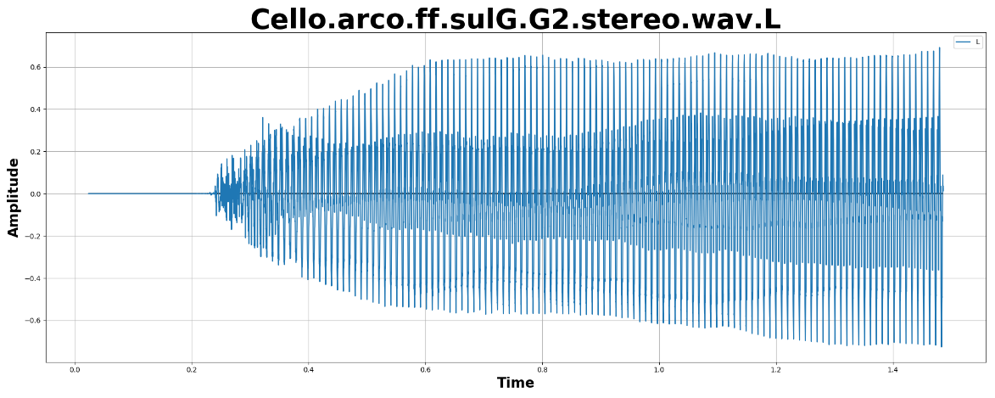
Data Input – Images & Audio
Most commonly, they tend to take the form of an array
Most types of inputs can be converted to arrays
The Images to the left can all be represented as a list of floats

Slide 11
Uses of CNNs
What can we do with them?

Slide 12
Image Recognition
Most common use for CNNs is Image recognition (Geron)
Also used for voice recognition, and language processing

Slide 13
An Example – Image Classifier
MNIST has a database of 70,000 handwritten figures
Each figure is 28 x 28 pixel image
We can use this as a quick practical example

Slide 14
Resources
Sanderson, Grant. But What Is A Neural Network? 3Blue1Brown, www.3blue1brown.com/neural-networks.
“Convolution Neural Networks.” Hands-on Machine Learning with Scikit-Learn and TensorFlow Concepts, Tools, and Techniques to Build Intelligent Systems, by Géron Aurélien, O'Reilly, 2017, pp. 361–386.

